Slide 1

Notes:
EPPC25 Branded Splash Screen
Slide #1 on all presentations.
The speaker should not edit, move or delete this slide.

Slide 2

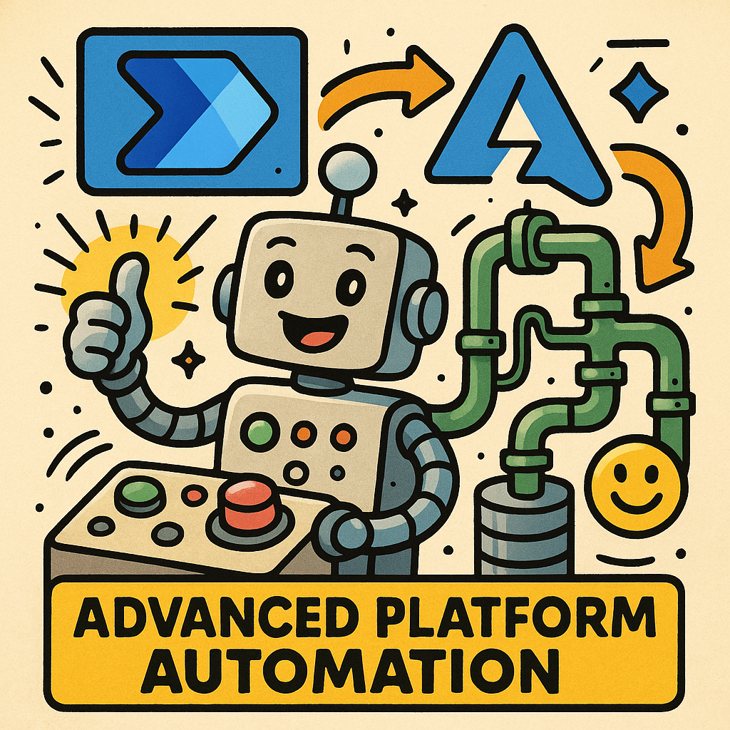
Lab 2 – Custom Connectors
(connecting to an Azure Function)
Advanced Integrations Workshop @ EPPC
Custom Connectors bridge Pro- and Low-Code!
Notes:
Presentation Title Slide
Please input your presentation title, your name, title, company name and country.

Slide 3
Custom Connector Intro 🙂

Slide 4
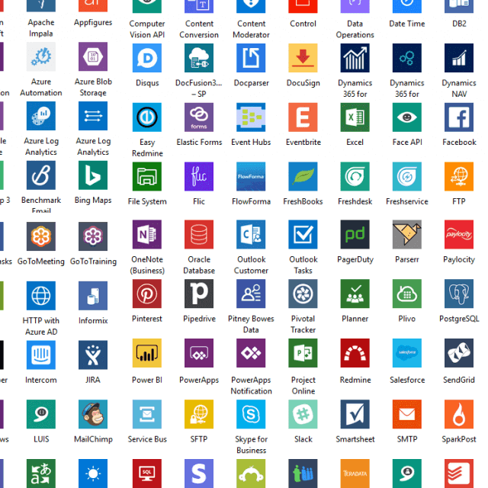
🔌 Standard Connectors 📈 Over 1600
Added all the time,
Always check them first!

Slide 5
Create your own Custom Connectors
You want more?
When there is no standard
Unlimited # of possibilities
Wrapper for any api / webservice

Slide 6






How do they work?
Actions
Triggers
HTTP
Cloud API

Slide 7


How do they work?
Actions
Triggers
HTTP
Gateway
On-Premises API

Slide 8
Example scenario 🌍

Slide 9






Scenario
Imagine there is an API for all the community events to query basic data and sessions!

Slide 10
Let’s connect to it!
🙌
Notes:
Section Break Slide
Use this slide for starting a new section of the presentation.
Input the name of the section in the text field.

Slide 11
The Backend / Datasource 💾

Slide 12
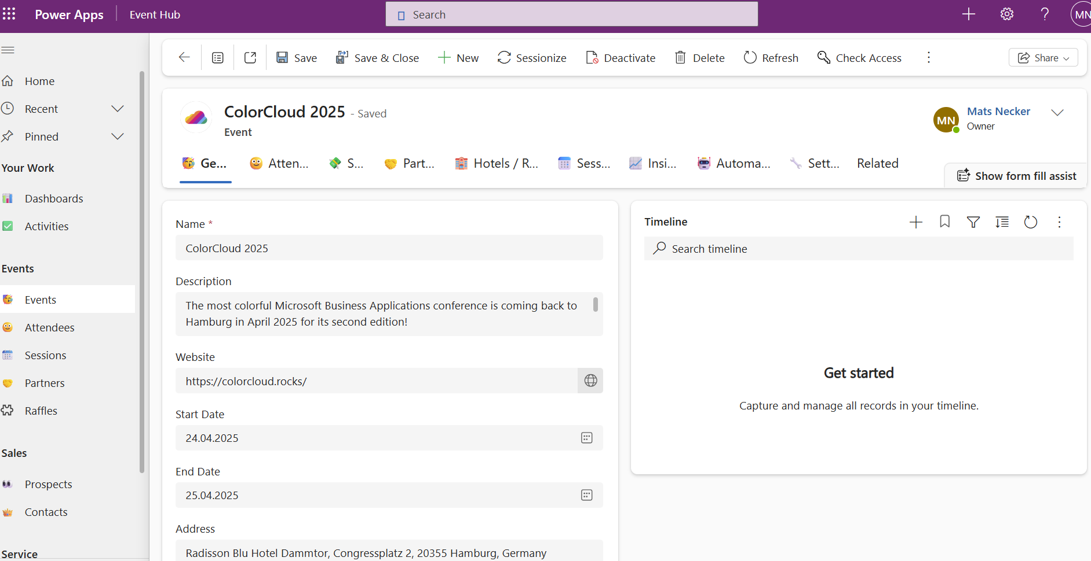
Dataverse / Model Driven Apps
Attendee Management
Sessions / Speaker
Hotel Room Bookings
Partner Management
Sales
Feedback
And more!

Slide 13
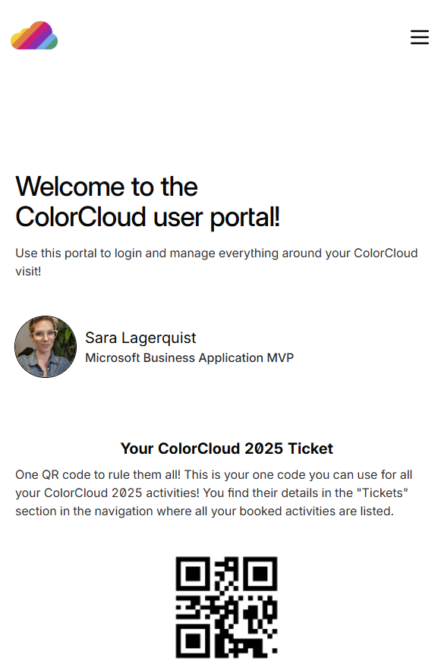
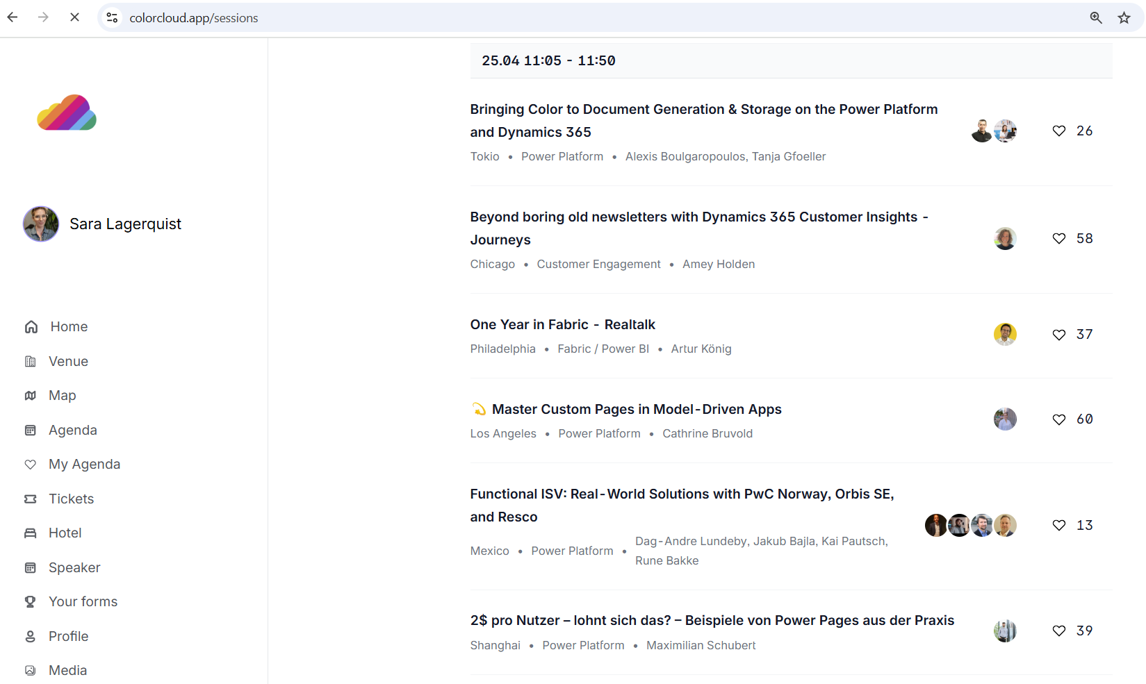
Mobile App

Slide 14
API 🔗

Slide 15
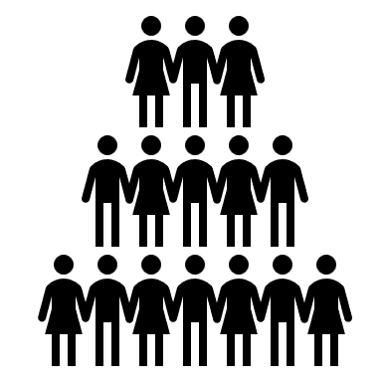

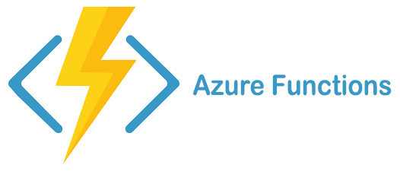
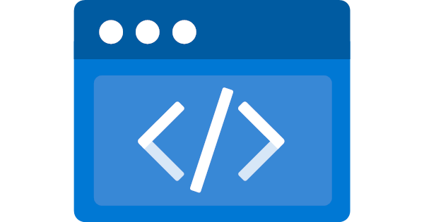

Behind the scenes
Community using Power Platform + Azure for their Event Management
Trigger Build
Consume
Get Data
Dataverse
Static Web App
M365 Tenant
Azure
API Management
External Users

Slide 16
Behind the scenes
We use a Custom Connector to connect with their API
Get Data
Consume
Dataverse
Static Web App
M365 Tenant
External Users
Azure
API Management
Custom Connector
Workshop Tenant

Slide 17
Ways to create a new custom connector
Create from blank
Create from Azure Service (Preview)
Import an OpenAPI file
Import an OpenAPI from URL
Import a Postman collection
Import from GitHub
This Lab!

Slide 18
Step by step: Build a custom connector
Read the docs / know the API you want to build the connector for
Start in one of the products (Power Apps, Power Automate or Logic Apps)
Set up the authentication
Define the operations (triggers / actions) for your connector
Add code if needed (for now, C# code is supported)
Save and test your connector

Slide 19

Let‘s build it!

Slide 20

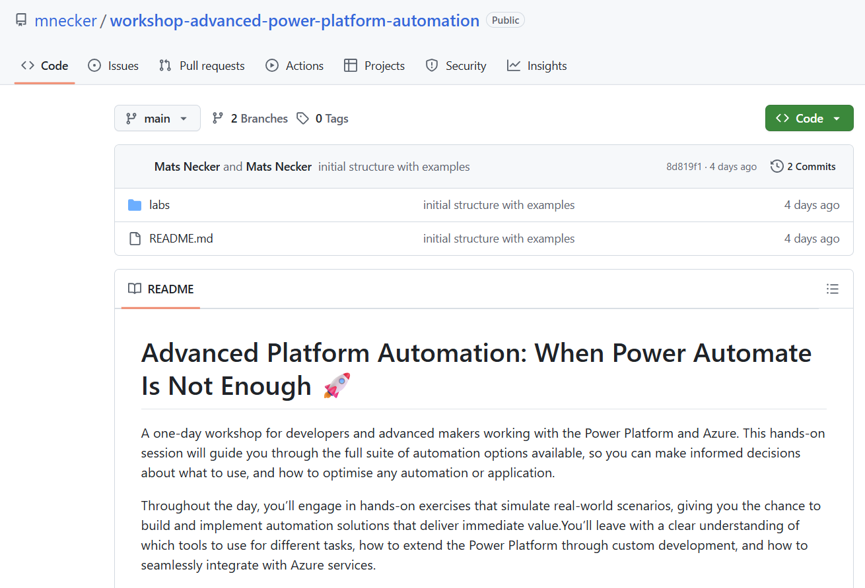
The Lab Material
https://github.com/mnecker/workshop-advanced-power-platform-automation

